Slide 1
Classification and Regression Trees (CART) and
Random Forests
Hongyu Guo
Guo7407@saskpolytech.ca

Slide 2
Outline
Tree based methods
Regression Trees
Bagging

Slide 3

Tree-based methods

Slide 4
x₂
Region2
Region1
x₂ª
Region3
x₁ª
x₁

Slide 5
X₁<x₁ª
x₁>x₁ª
X₂<x₂ª
x₂>x₂ª

Slide 6
Why Trees?
What would you do tonight? Decide amongst the following:
Finish homework
Go to a party
Read a book
Hang out with friends

Slide 7
Homework Deadline tonight?
Yes
No
Do homework
Party invitation?
Yes
No
Do I have friends
Go to the party
Yes
No
Read a book
Hang out with friends

Slide 8
Why Trees?
We split the predictor space as brunches of a tree and therefore these methods are called decision tree methods

Slide 9

Why Forest?
Not the most powerful models but using multiple trees as in bagging, random forests and boosting yield much better results.

Slide 10
Outline
Tree based methods
Regression Trees
Bagging

Slide 11
Regression
Build a regression tree:
Divide the predictor space into J distinct not overlapping regions R₁,R₂,R₃,…,R_{J}
We make the same prediction for all observations in the same region; use the mean of responses for all training observations that are in the region

Slide 12
x₂
Region2
Region1
y=2.2
y=3.2
Region3
y=5.6
x₁

Slide 13
Finding the sub-regions
The regions could have any shape.
But we choose just rectangles
x₂
Region2
x₂
Region2
Region1
Region1
Y=2.5
y=2.2
Y=2.9
Y=3.2
Region3
Region3
Y=5.1
y=5.6
x₁
x₁

Slide 14
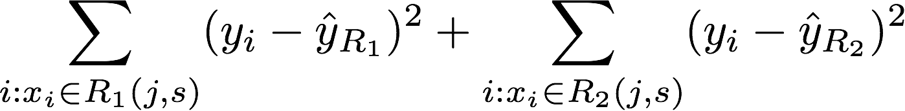
Recursive Binary Splitting
Consider all predictor X_{p} and all the possible values of the cutpoints s for each of the predictors. Choose the predictor and cutpoint s.t. it minimizes the RSS(Residual sum of squares)
  This can be done quickly, assuming number of predictors is not very large
Repeat #1 but only consider the sub-regions
Stop: node contains only one class, or node contains less than n data points or max depth is reached
Notes:
RSS Residual Sum of Squares.

Slide 16
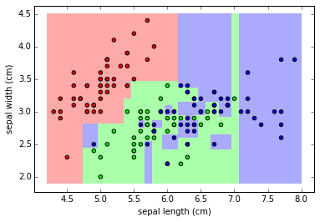
Overfitting
If we keep splitting we will be reducing RSS

Slide 17
Pruning
Reducing the number of splits or regions in a model leads to lower variance, enhancing interpretability. However, this comes at the expense of introducing a slightly higher bias.
Ideas?
Stop splitting when RSS improvement is lower than a threshold.

Slide 18
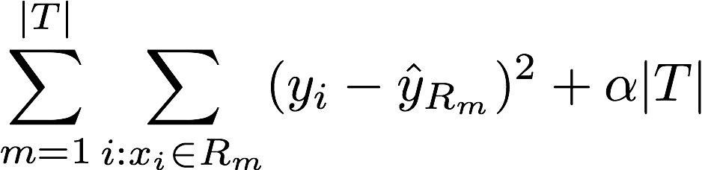
Cost complexity pruning
Consider a tuning parameter α that for each value of α there is a subtree that minimizes
Where |T| is the number of terminal nodes. α controls the complexity of the tree similarly we saw with other regularizations (e.g. LASSO).
It turns out that as we increase α from zero in, branches get pruned from the tree in a nested and predictable fashion, so obtaining the whole sequence of subtrees as a function of α is easy.
Notes:
If a is zero this is the full tree … a large only root node

Slide 19
ALGORITHM FOR PRUNING
Use recursive binary splitting to grow a large tree on the training data, stopping only when each terminal node has fewer than some minimum number of observations
Apply cost complexity pruning to the large tree in order to obtain a sequence of best subtrees, as a function of α
Use K-fold cross-validation to choose α
  Repeat #1 and #2 on the k-th fold
  Estimate the MSE as a function of α
  Average all and pick α
Return the subtree from Step 2 that corresponds to the chosen value of α

Slide 20
Advantages of tree-based methods
Easy to explain
Handle qualitative predictors
Display graphically and easy to interpret
More similar to human decision making

Slide 21
Disadvantages
Non robust. Sensitive to small changes in the data
Trees generally do not have the same level of predictive accuracy as some of the other regression and classification approaches, we have seen
Only axis aligned splits

Slide 22

Power of the crowds
Wisdom of the crowds
http://www.scaasymposium.org/portfolio/part-v-the-power-of-innovation-and-the-market/

Slide 23
Ensemble methods
A single decision tree does not perform well
But it is super fast
What if we learn multiple trees?
We need to make sure they do not all just learn the same

Slide 24

Bagging
If we split the data in random different ways, decision trees give different results, high variance.
Bagging: Bootstrap aggregating is a method that result in low variance.
If we had multiple realizations of the data (or multiple samples) we could calculate the predictions multiple times and take the average of the fact that averaging multiple onerous estimations produce less uncertain results
Notes:
General purpose method, here only for decision trees
In statistics, variance measures variability from the average or mean. It is calculated by taking the differences between each number in the data set and the mean, then squaring the differences to make them positive, and finally dividing the sum of the squares by the number of values in the data set.

Slide 25
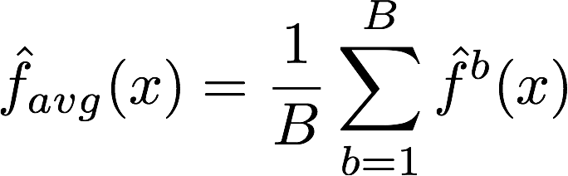
Bagging
Say for each sample b, we calculate f^{b}(x), then:
How?
Bootstrap
Construct B (hundreds) of trees (no pruning)
Learn a classifier for each bootstrap sample and average them
Very effective
Notes:
No pruning, high bias high variance

Slide 26
Out-of-Bag Error Estimation
No cross validation?
Remember, in bootstrapping we sample with replacement, and therefore not all observations are used for each bootstrap sample. On average 1/3 of them are not used!
We call them out-of-bag samples (OOB)
We can predict the response for the i-th observation using each of the trees in which that observation was OOB and do this for n observations
Calculate overall OOB MSE or classification error
Notes:
equivalent to leave-one-out cross-validation error
1/N to choose, 1-1/N not to choose, (1-1/N)N and (1-1/N) 1-(1-1/N)N 1-e^(-1)

Slide 27
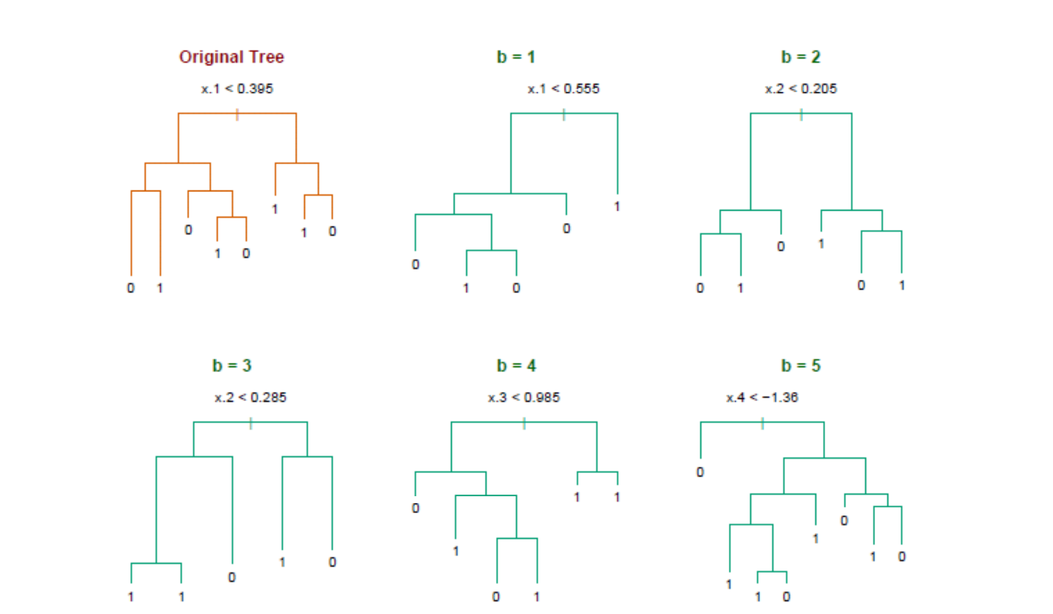
Bagging decision trees
Hastie et al.,”The Elements of Statistical Learning: Data Mining, Inference, and Prediction”, Springer (2009)

Slide 28
Bagging
Reduces overfitting (variance)
Normally uses one type of classifier
Decision trees are popular
Easy to parallelize

Slide 29
Bootstrap Samples
Sample with replacement.
Training data (y₁, x₁),…. (y_{n}, x_{n}).
Randomly draw one, denote as (y₁*, x₁*); make a copy and put it back.
Repeat for n times, then we have (y₁*, x₁*)….. (y_{n}*, x_{n}*). This is called a bootstrap sample.
Repeat everything for B times, then we have B bootstrap samples.

Slide 30
Random Forest Classifier
Training Data
M features
N examples
Notes:
As the classifier of choice we adopt Random Forest Classifier, due to its robustness to heterogenous and noisy feature.
Random Forest is an ensembe classifier. Briefly, given N data and M features, bootsrap samples are created from the traning data

Slide 31
Random Forest Classifier
Create bootstrap samples
from the training data
M features
N examples
....…

Slide 32
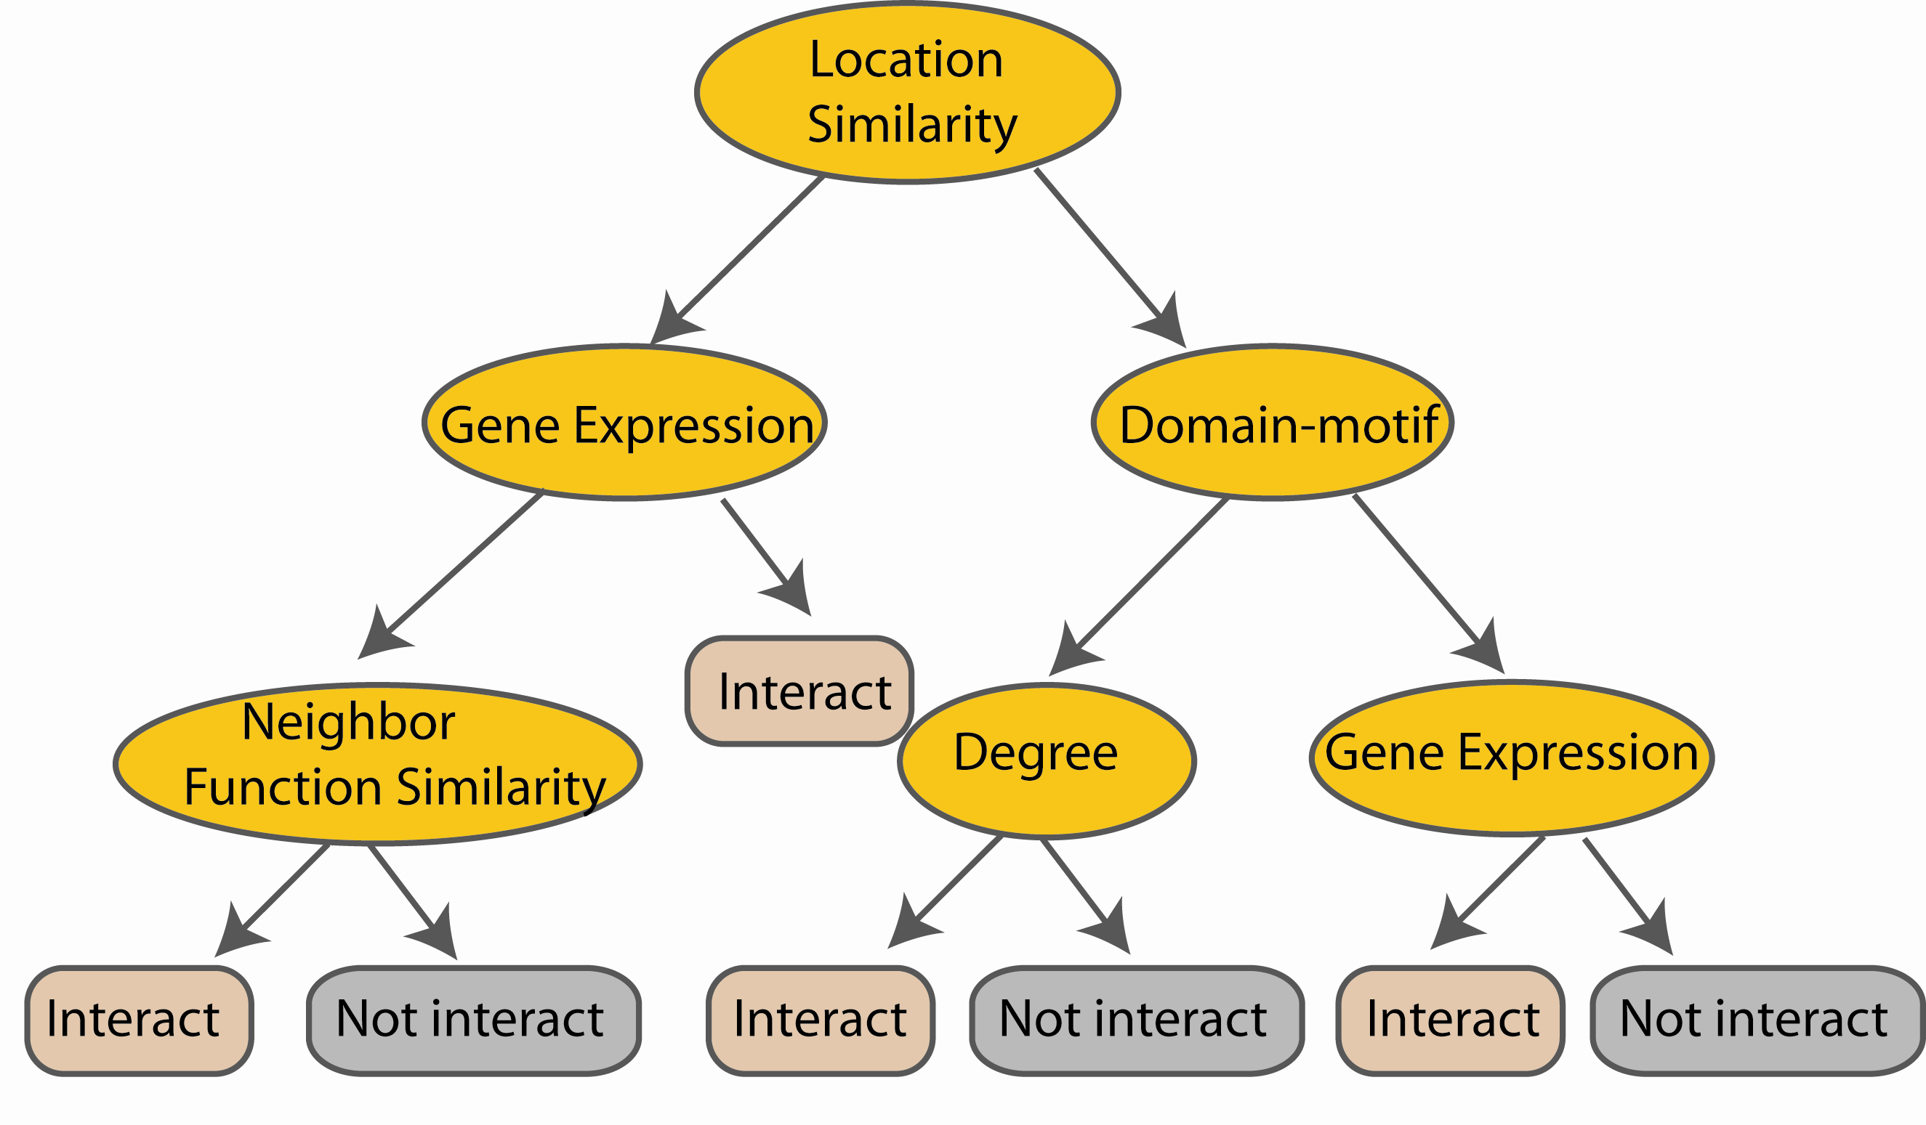
Random Forest Classifier
Construct a decision tree
M features
N examples
....…
Notes:
From eachd descision tree .. In spliting the nodes, the Gini Gain is employed

Slide 33
Random Forest Classifier
At each node in choosing the split feature
choose only among m<M features
M features
N examples
....…
Notes:
Different from the regular decision trees in random forest, when the splitting feature is chosen from only a subset of allf eatures.
The robostness of the classifier arises from
bootsraping of the training data and the random selection of features, the the random choose of features.

Slide 34
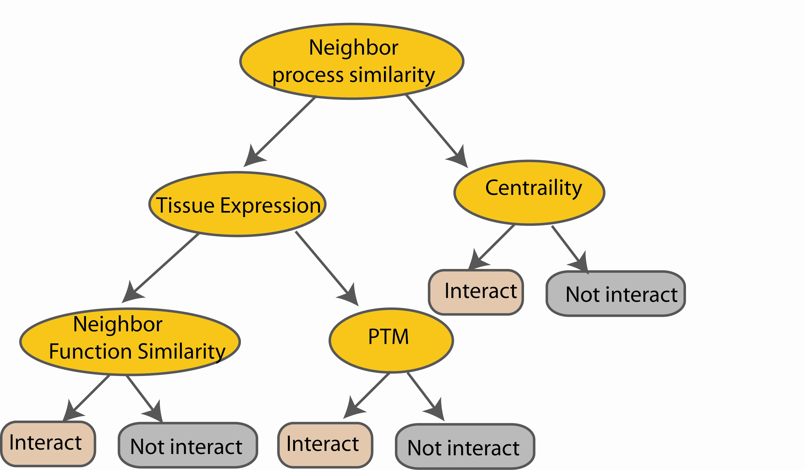
Random Forest Classifier
Create decision tree
from each bootstrap sample
M features
N examples
....…
....…

Slide 35
Random Forest Classifier
M features
N examples
Take he majority vote
....…
....…
Notes:
Finally the given an input data the decision is made as follows given an input data,

Slide 36
Random forest
Available package:
http://www.stat.berkeley.edu/~breiman/RandomForests/cc_home.htm
To read more:
http://www-stat.stanford.edu/~hastie/Papers/ESLII.pdf

Slide 37
Ensemble Classifiers
Bagging (Breiman 1996): Fit many large trees to bootstrap resampled versions of the training data, and classify by majority vote.
Boosting (Freund & Schapire 1996): Fit many large or small trees to reweighted versions of the training data. Classify by weighted majority vote.

Slide 40
In general,
Boosting > Bagging > Single Tree.

Slide 41
Decision Tree Feature Importance
Decision tree algorithms like classification and regression trees (CART) offer importance scores based on the reduction in the criterion used to select split points, like Gini or entropy.

Slide 42
Variable Importance Measures

Slide 43
Find important features with Random Forest model
  https://www.kaggle.com/code/prashant111/random-forest-classifier-feature-importance

